Slide 1

Library management system
By Team 5,
Avinash Ganguri (Class ID: 11)
Bindu Gadiparthi (Class ID: 10)
Jagadheesh Maroju (Class ID: 19)
Mehmet Acikgoz (Class ID: 1)

Slide 2


Story of the project
People going to an actual library for just the sake of checking a book availability or renewing a book is a process that should be minimalized. During Covid-19, maintaining social distance and accessing such features through online is the safest way.
Moreover, library management is a troublesome process in maintaining all the records manually with the quantity list and their issue, renewal dates. Through an online application, it makes safer and easier way for all the Students and Staff in accessing and maintaining book services.
Either a bibliophile or a bookworm, anyone who wants to read a book can use this application for ease, instead of going to an actual library for certain features.

Slide 3
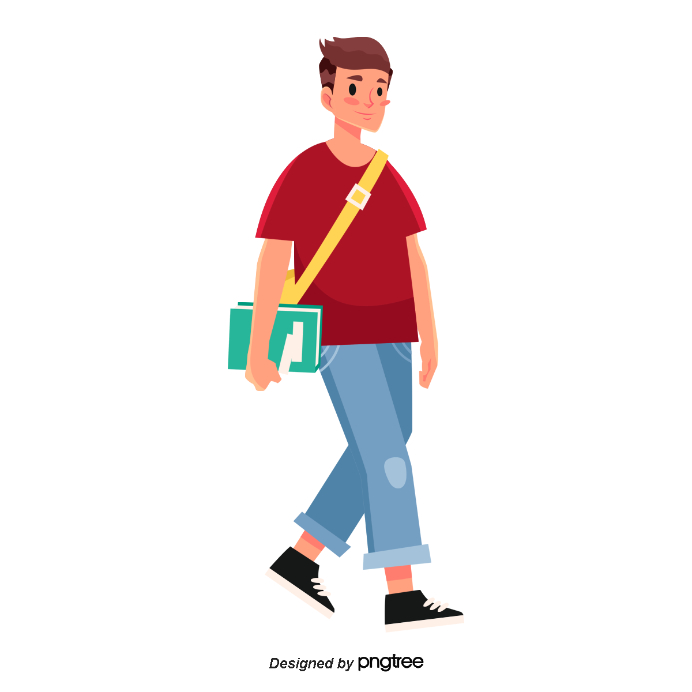

WHO:
Lucy is a busy 23-year-old graduate studying in University of Missouri at Kansas City who lives in Overland Park, KS. He works part time as a student lab assistant and manages his time between assignments, exams and work. He lives alone and has many other duties to fill in a household. In his free time, he spends time with friends, reading books and watching movies.
WHAT:
Lucy has a difficulty in managing time between all his activities and he’s focusing on to improve his productivity. He’s trying to simplify his lifestyle and being safe by not traveling for simple things. Being a bibliophile, he reads a lot of books and doesn’t want to take extra time to go to an actual library for checking book availability or renewing a book.
WHEN:
After Covid-19, people are trying to be safe by staying in home and avoiding traveling for simple tasks. Lucy one among them also focusing on improving his productivity where such services being online can be a lot helpful and time saving process in the modern era for everyone.

Slide 4

WHERE:
Community of Overland Park, Kansas. Within the city limits there are only a few libraries and many out of them are closed due to Covid-19 restrictions. And Lucy staying far from his university and it is quite difficult for him to travel all along the way from Overland Park to Kansas City for just renewing a book. And also, for the staff who works in library, managing all the books and their date of issues and renewals in manual record format is quite difficult.
However, if Lucy and the staff at UMKC face this problem, we could wonder how many people or schools face such difficulty as this problem.
WHY:
Managing books and their renewals is a tiresome process and there might be a chance of errors. Through an online application portal, it is easy for library management for both the Students and Staff with proper and accurate details to access certain features. Moreover, a portal where users can search books with different categories and genres, find other user reviews on the particular book or comment their own review for it, changing renewal status and many such features can be done at ease with an application rather than a manual library system.
There are people like Lucy who wants to maximize their productivity with ease and safe environment.

Slide 5
DATA That helps the project

Slide 6
Data demography
Similar data is collected for both users and the staff.
First Name
Last Name
Email ID
Password

Slide 7
WHO:
The dataset we're using is a manually created dataset that includes information about all of the books present in the UMKC library, and it's aimed at undergraduate and graduate students from various backgrounds. We use Google Books API for certain features such as book image or book description as well. The dataset's fields reflect the story's key characteristics.
WHAT:
Our dataset includes many records with an estimated of 8 columns, two of which will be changed during the runtime. The names of the columns, as well as their descriptions, are mentioned below.
Title: The title or name given to the book.
Author: The name of the author.
Description: About the book in a detailed way.
Genre: The category of the book.
Location: The location of the book will be updated in this column.
Rating: The review of the book can be viewed in this column.
Quantity: The number of books taken will be updated in this column.
Issue date: On the day the book is published, this column is updated with the current date.

Slide 8
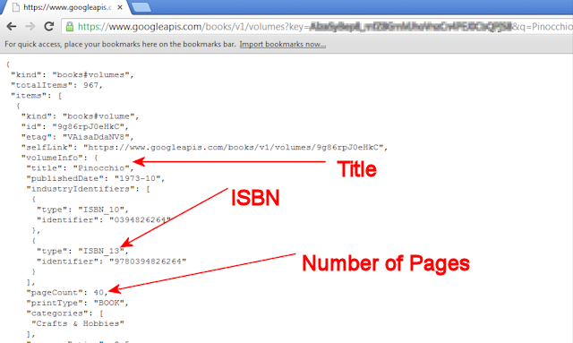

Slide 9
WHEN:
During Spring 2021 term, the data will be obtained from the UMKC library website. The information gathered is cross-sectional. The information reflects a series of books released between 2009 and 2021 in the UMKC library.
WHERE:
There are no geographical details in this dataset. The information in the dataset pertains to the library's selection of books for undergraduate and graduate students at UMKC.
WHY:
The data will be collected for a better understanding of the book availability that are present in the university and also helps students to get a glance of their availability and ease of renewals. Also, helps the staff to manage the book inventory without any Hussle.
HOW:
We've added two new columns to the table: Quantity and Issue date, which are changed when a book is published and returned. The changes done will be updated automatically.

Slide 10
Application IDEA FOR THE PROJECT

Slide 11
WHO:
This application can help people like Lucy, and also the library management to ease their tasks.
WHAT:
The application has certain features,
Lucy / Users can :
Able to search for a book using Author or Title
Able to filter book by book genre / category (ex: Technology, Business, Fiction, Management.....)
View Book details like Author, Title, Thumbnail image, ISBN, Description
Issue the book to self, depending on the availability
Renew the book once for configured days
Return read book and review & rate the same
Notify the location of the book in the library while issued / returned
Set favorite genres (category) for user and display personalized list of book based on favorite genre
Display list of books with the user along with details like ‘Renew / Return by’ date-time

Slide 12
Admin / Library Staff can :
Add / Update (including no. of copies) / Delete books
Add using ISBN preferably by reading bar-code through mobile / tablet or entering the code
manually
Retrieve book details using ISBN through any public API’s. Details include title, author, description, social rating through good reads or google or any other sources
When book details are not available through public, allow admin to enter the details
manually
Display the list of books taken by users and filter by book title, book author, user id, user
name, issued date
Sort the above list by issued date, book title, book author, username

Slide 13
WHEN:
The user can use this application when he doesn’t want to spend extra time to go to an actual library. And the management can use any time for the ease of management.
WHERE:
The application is deployed in web and can access through any compatible web browser. Will also try to host into any of the hosting platforms such as Heroku or AWS.
WHY:
As discussed earlier, it can be helpful for both users and the staff to access and manage certain features in Library.
HOW:
This application can help people during this pandemic where users can stay at home and do the renewals and helps the staff in maintaining the records with error-free.

Slide 14
Working screens of the project

Slide 15
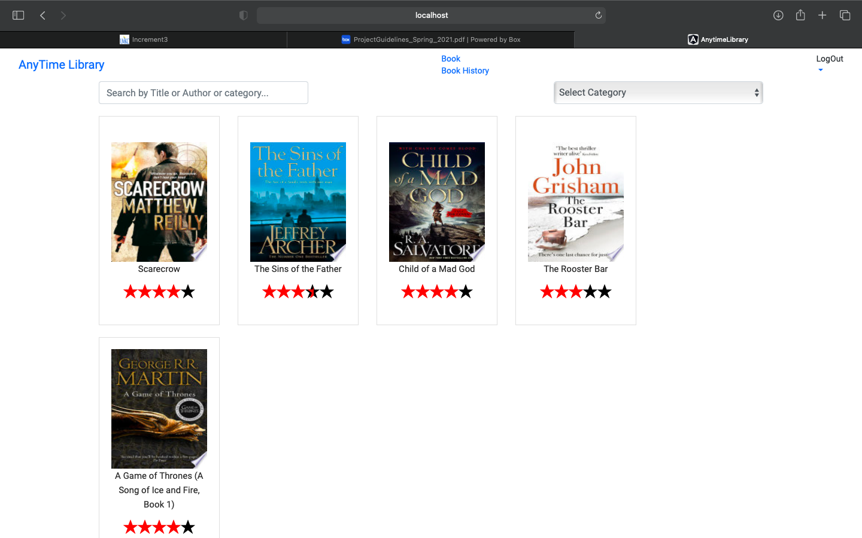
Home page of our Application – AnyTime Library (Library Management System)
Where all the books present in the library are displayed here with the user ratings.

Slide 16
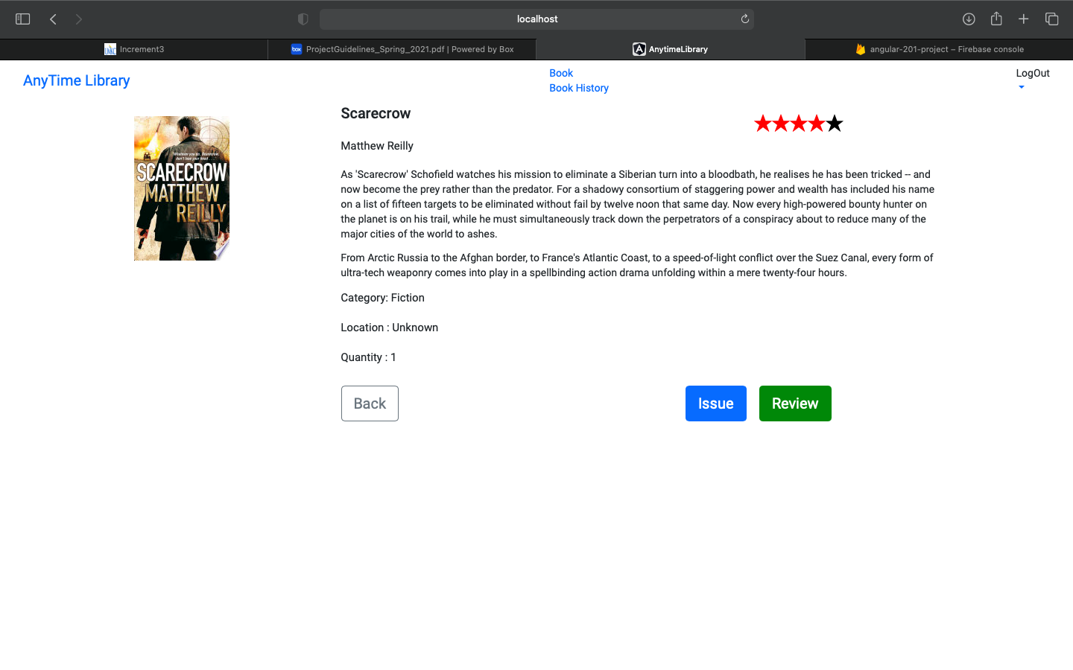
When the user selects a book, he can see the details of it including Category, Location and the book quantity.

Slide 17
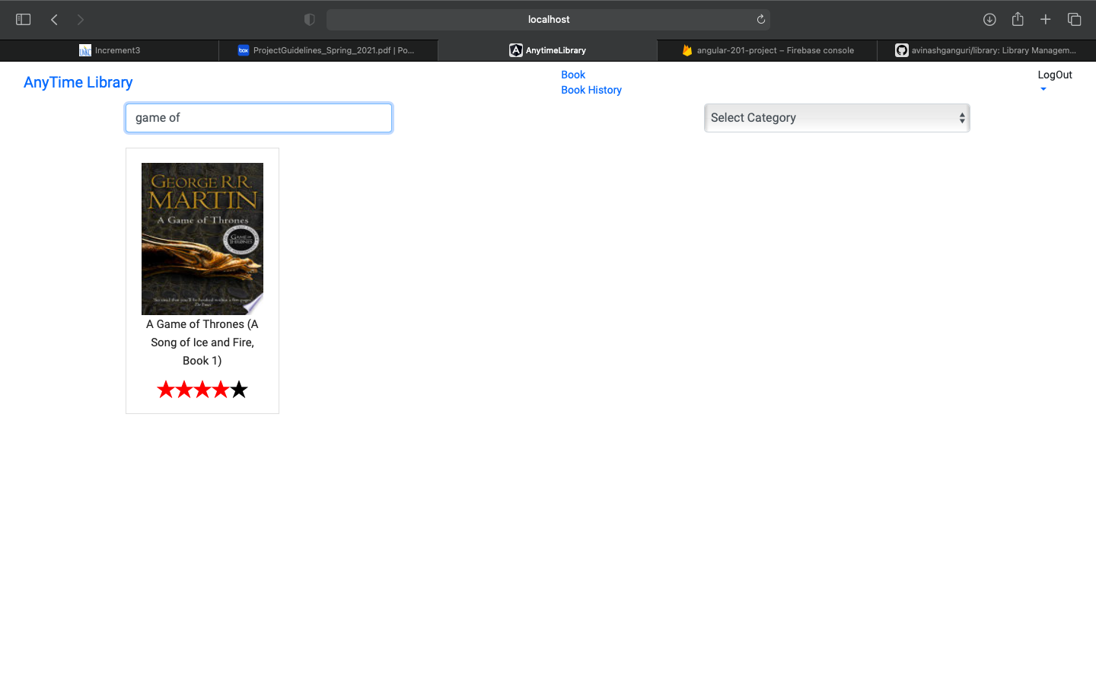
User can search book from the search bar provided.

Slide 18
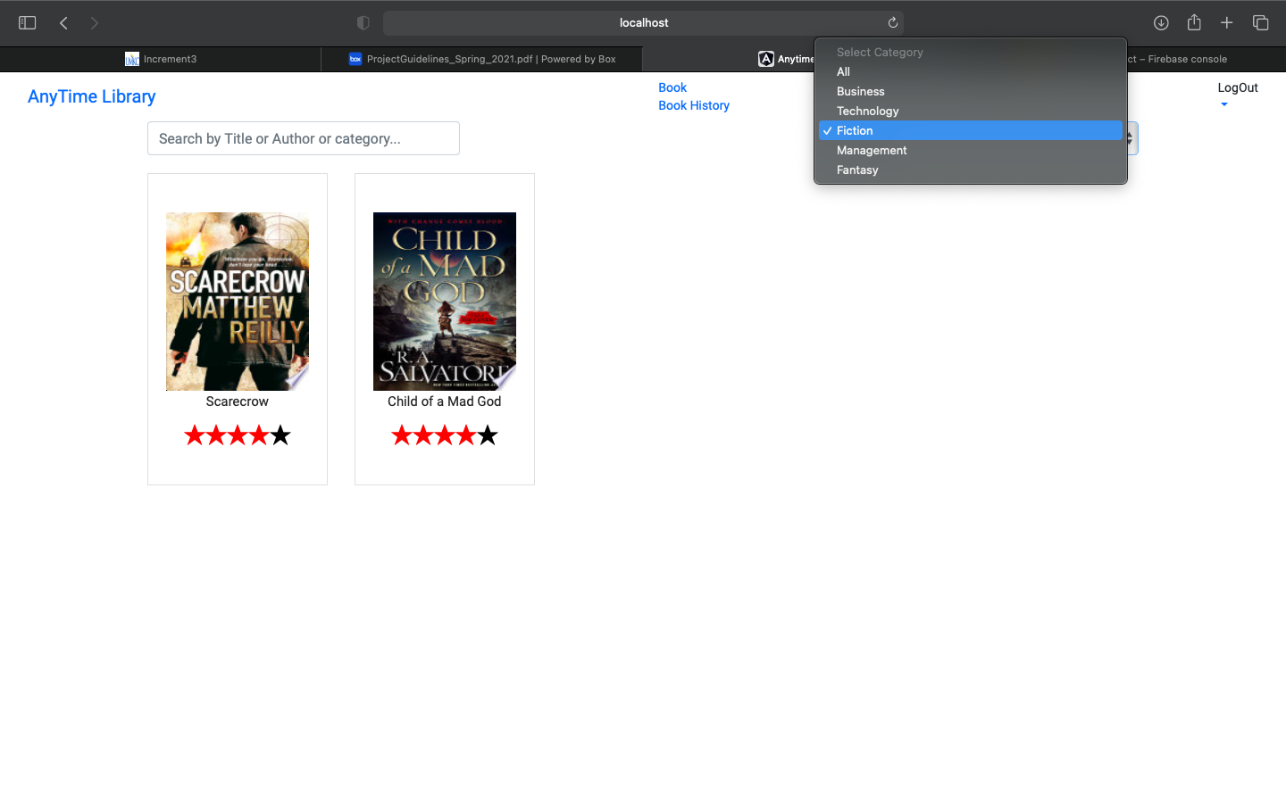
Also, user can select books based on different categories provided. And books are filtered based on the selected category.

Slide 19
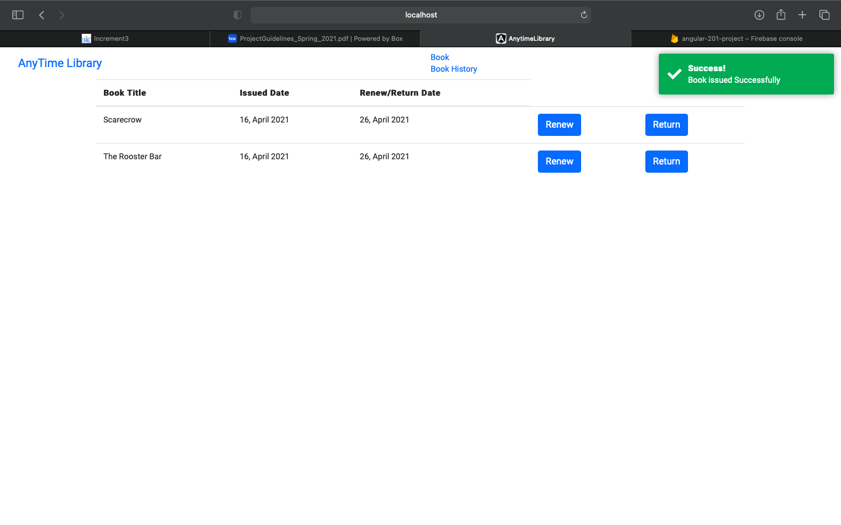
After issuing the books, they are added to the book history queue page where a user can renew or return the book.

Slide 20
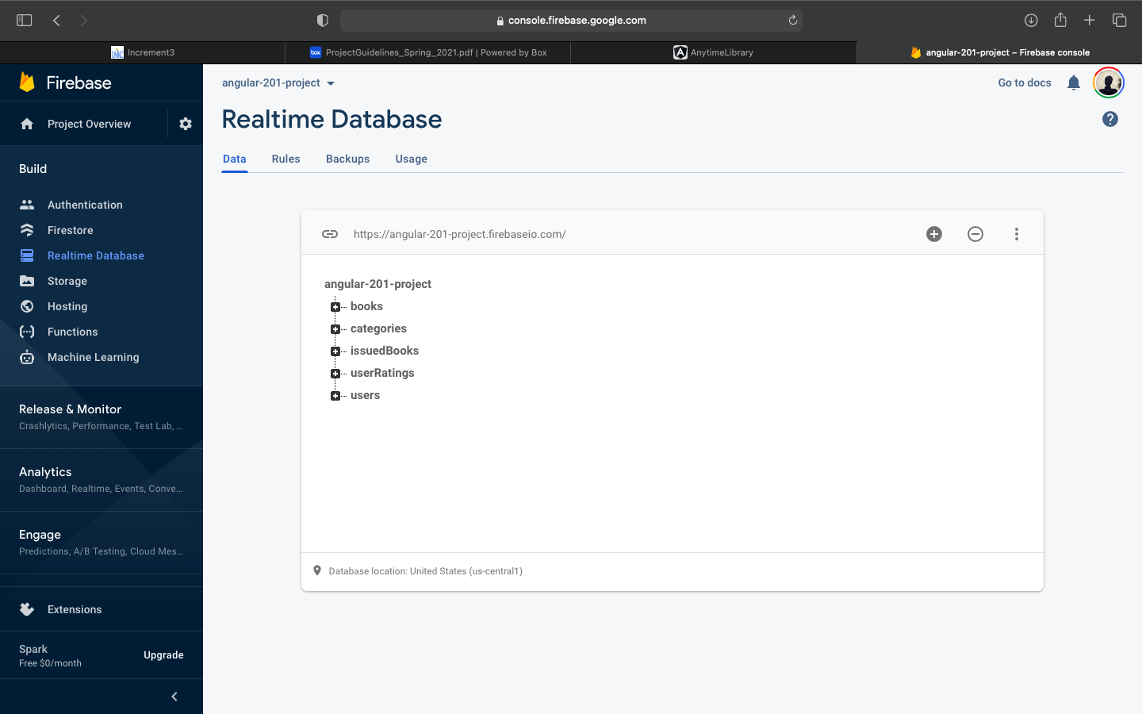
We have used Firebase Realtime Database for our project based on its different functionalities and analytic features.

Slide 21
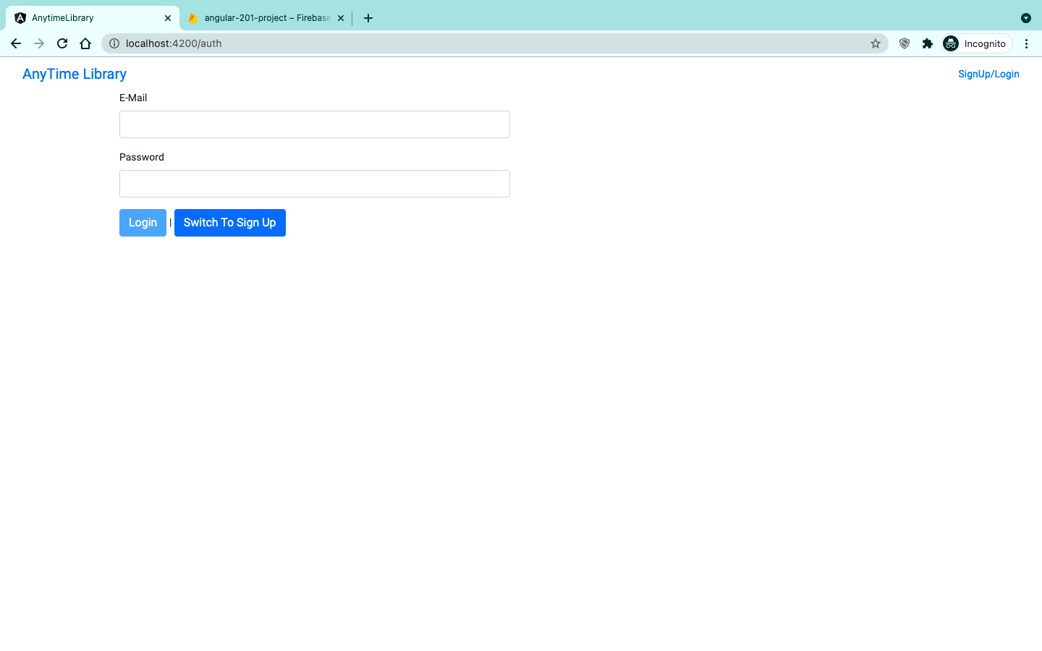
Authentication page to users for both login&sign up

Slide 22
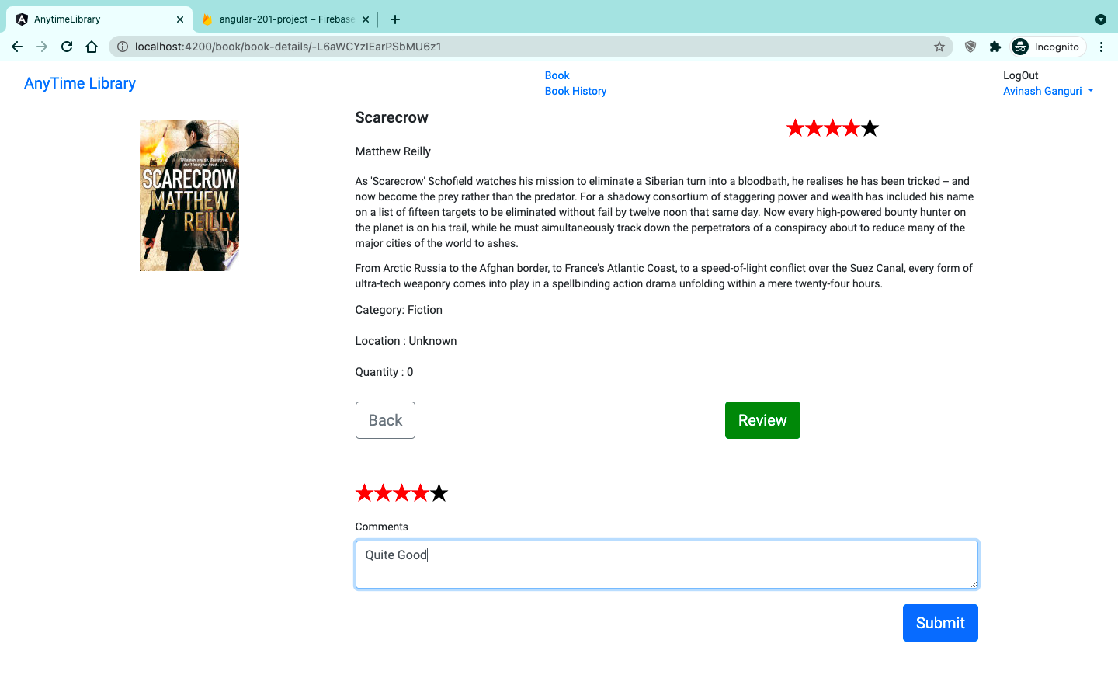
Now users can give a review and comment as well for the books.

Slide 23
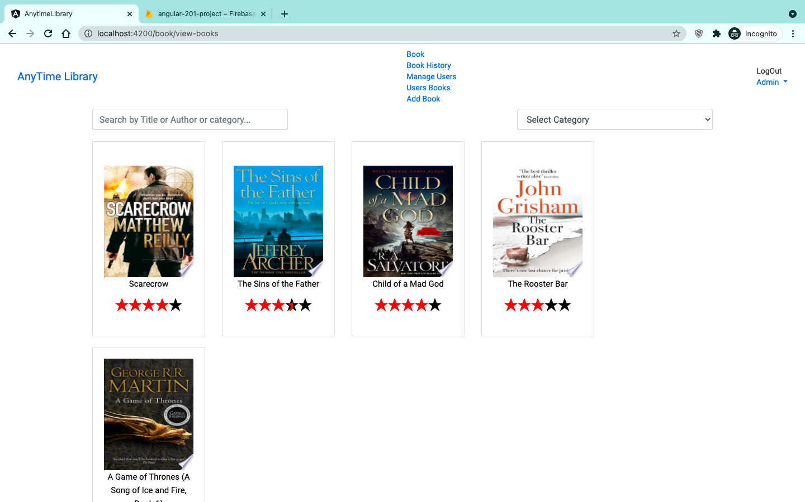
Admin has a lot of different functionalities and can be seen here,
He can
Add or update Users
Check on Users Books
Add or update a New Book

Slide 24
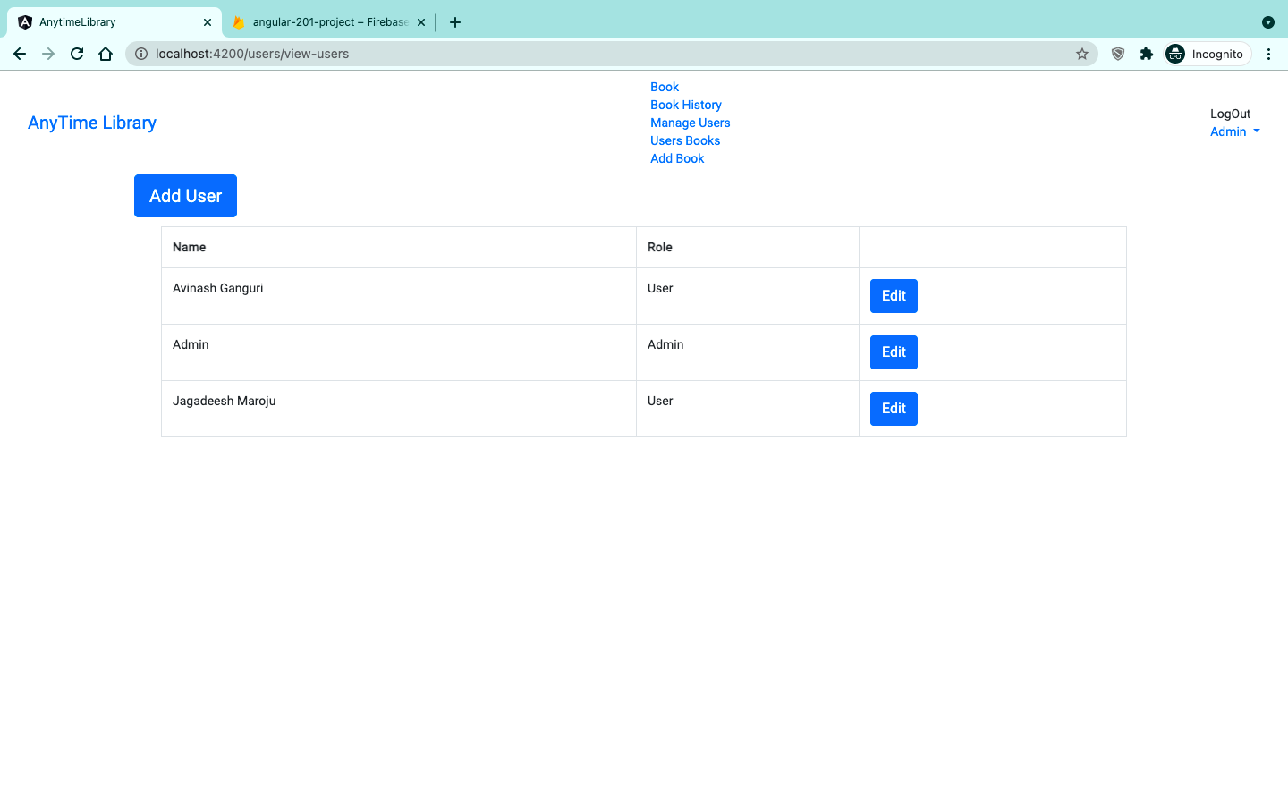
Here you can observe that he can add a new user and also can edit current users.

Slide 25
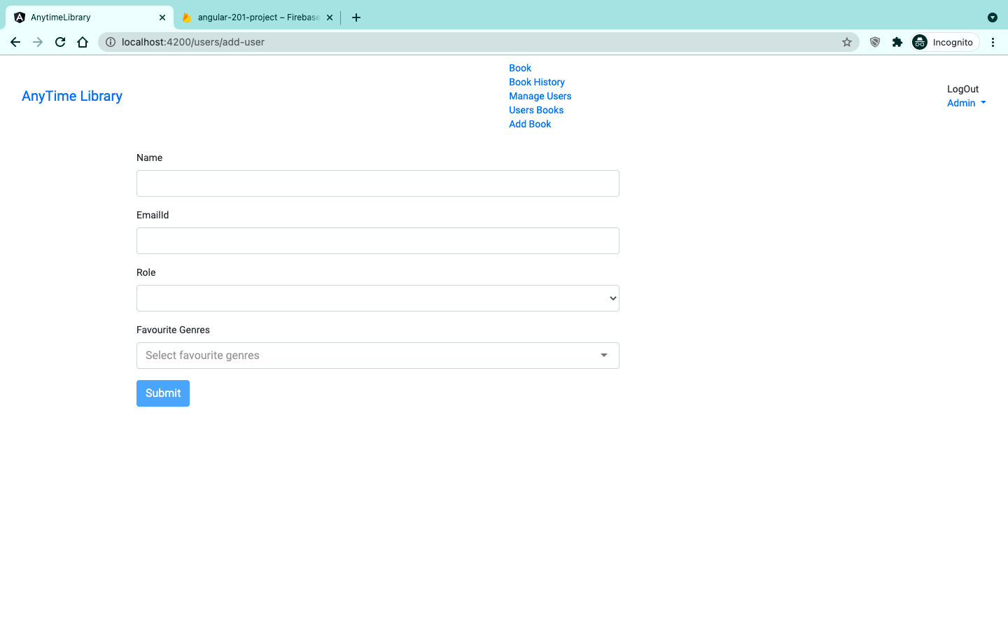
Adding a new user,

Slide 26
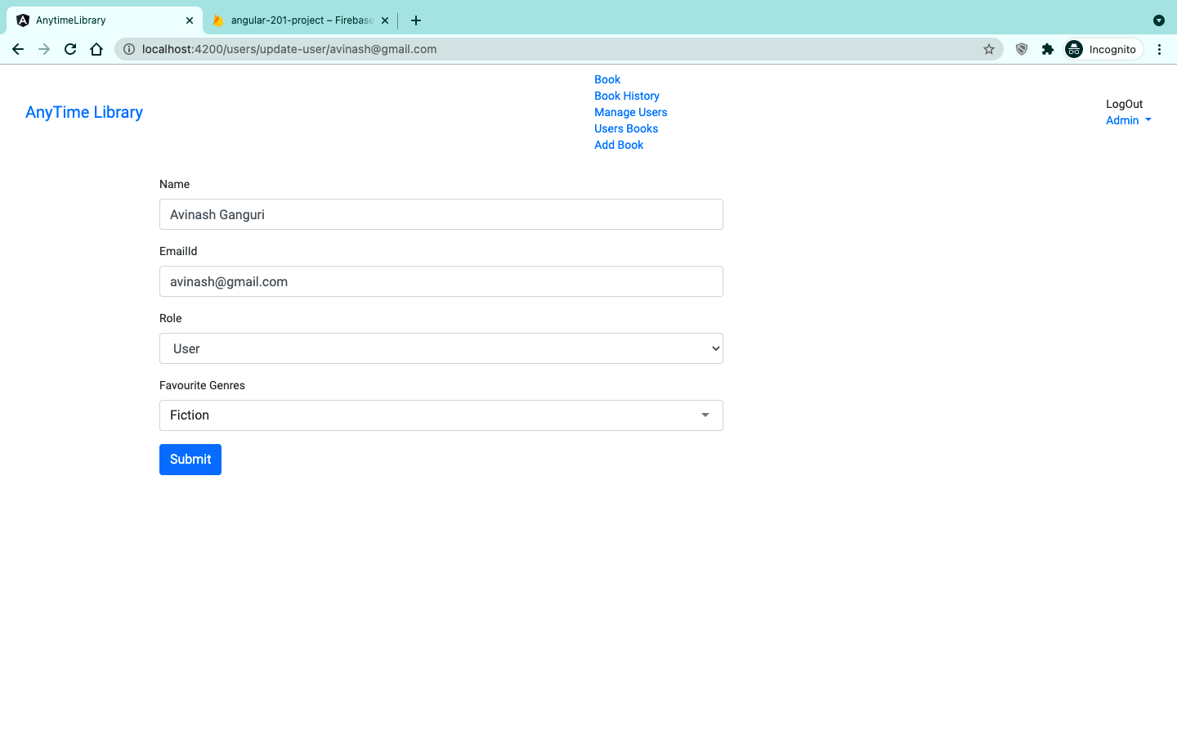
Updating a current user,

Slide 27
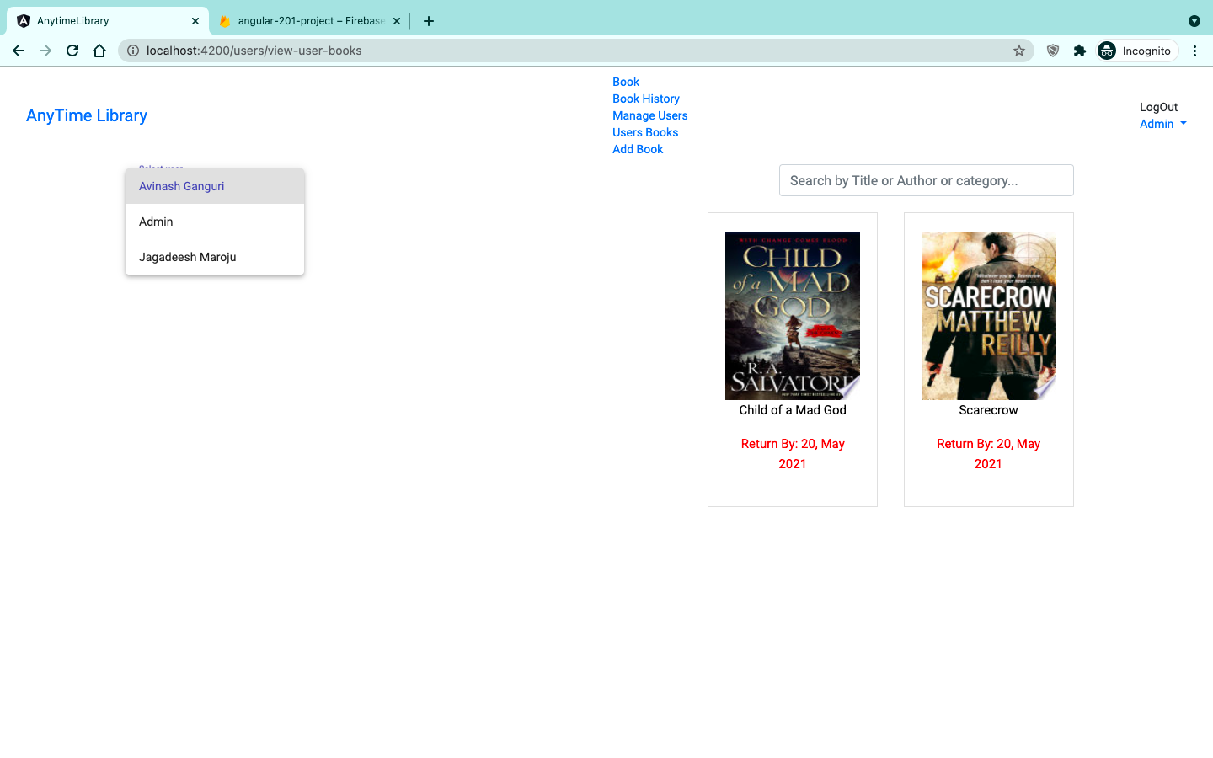
He can also view the books that are issued to different users,

Slide 28
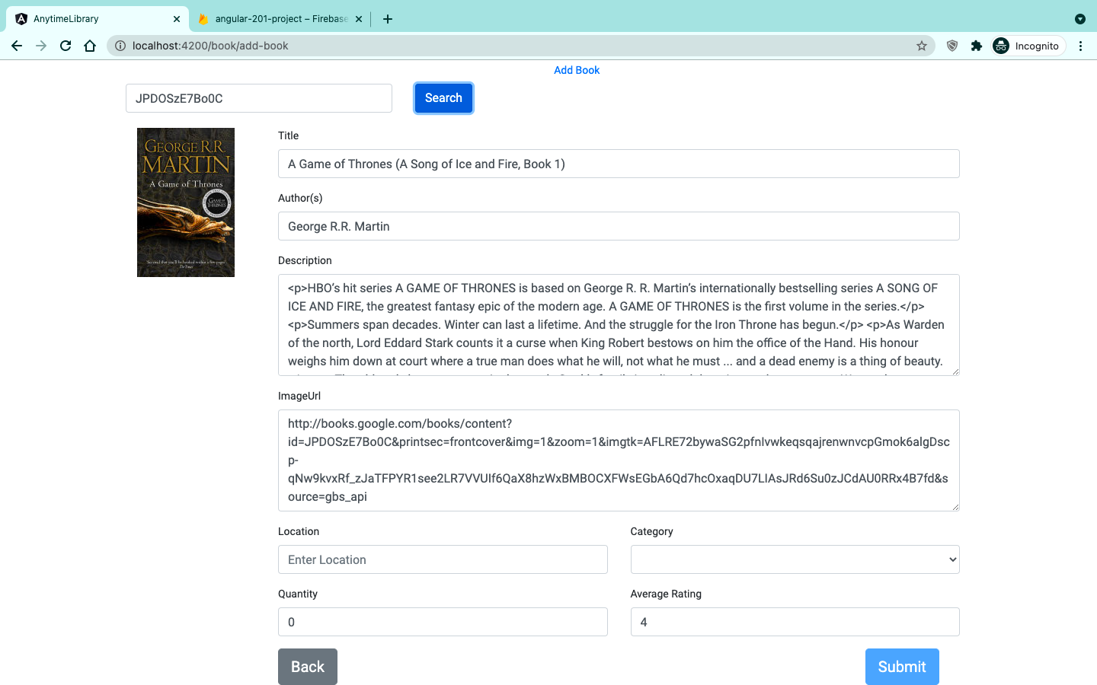
Adding a new book through ISBN, here the book details can be retrived by using Google Books API. And also if a particular book is not present or can’t be added through using ISBN, then he can add the book details manully as well.

Slide 29
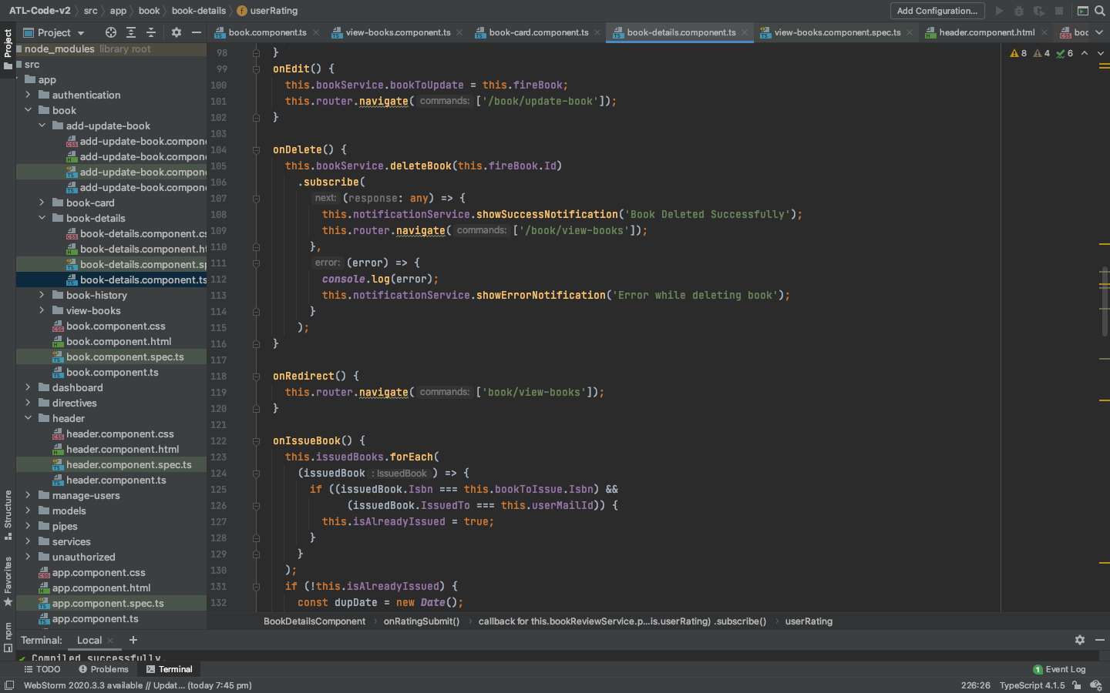
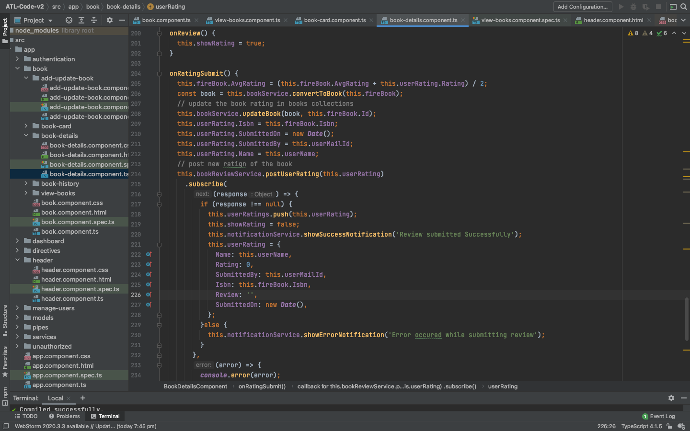
Important code snippets :
This is the code where it used for editing, deleting, redirecting a book takes place.

Slide 30
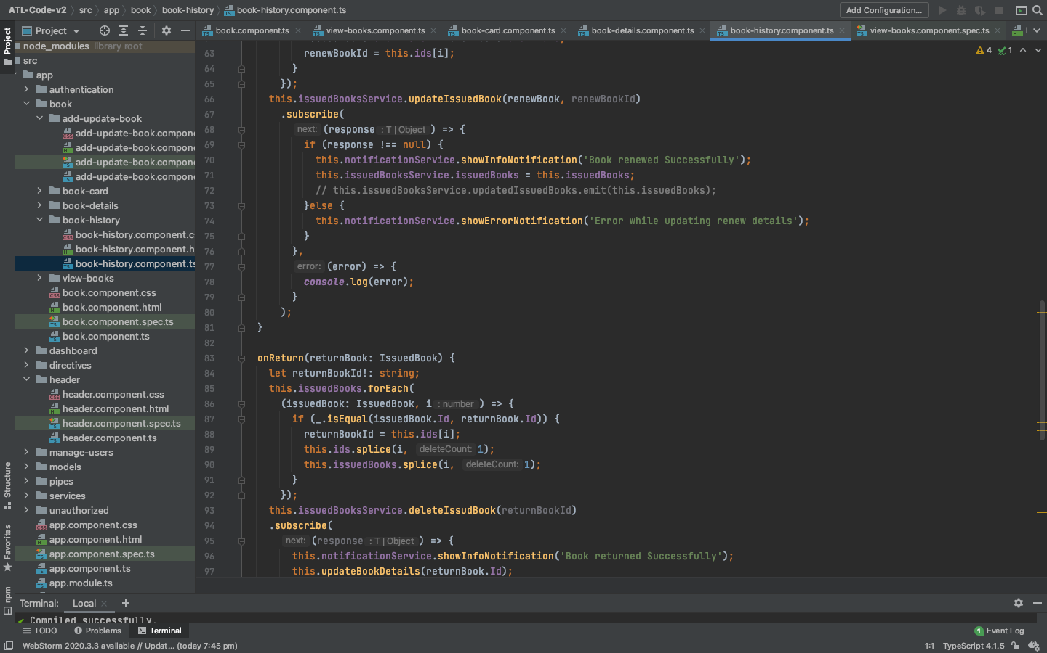
Here book history can be displayed,

Slide 31
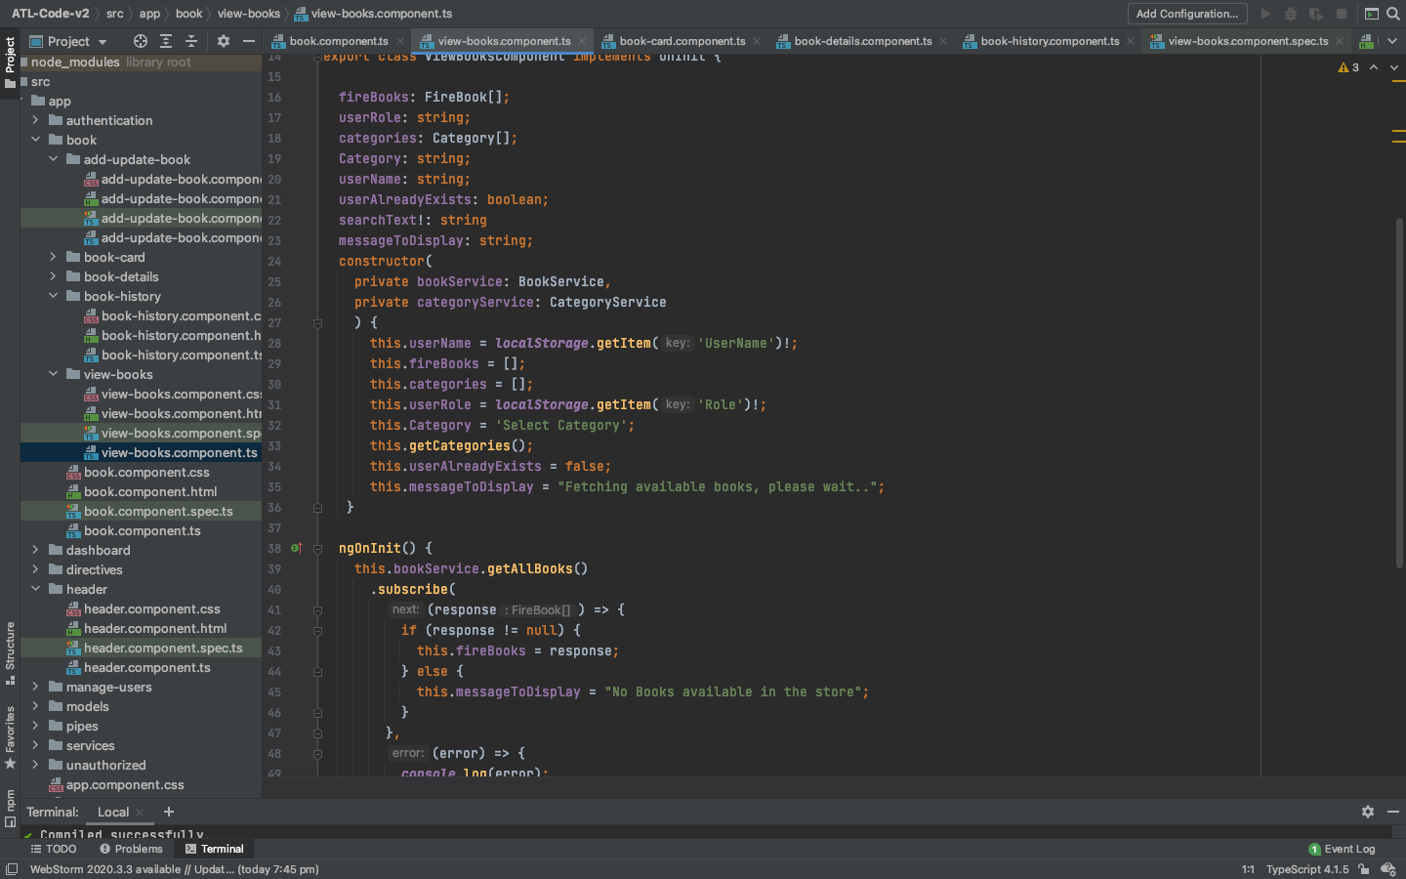
Book availability can be seen here,

Slide 32
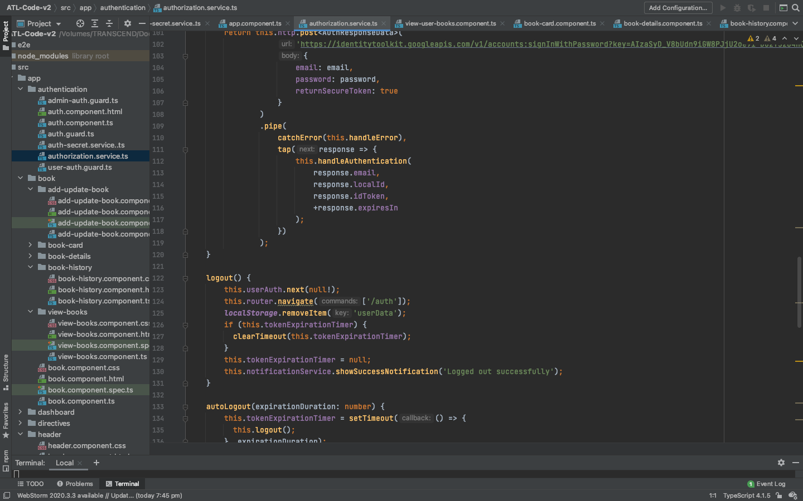
Authentication of the application,

Slide 33
WORK DISTRIBUTION
Avinash Ganguri – 25%
Jagadeesh Maroju – 25%
Bindu Gadiparthi – 25%
Mehmet Acikgoz – 25%
Bindu and Mehmet worked together in building the User Interface for the project and worked on adding the book issue queues and added authentication features to the application.
Avinash and Jagadeesh worked together in adding backend functionalities to the project by managing the firebase database and worked on admin functionalities for the project.

Slide 34
Issues with the project:
Storing and Retrieving data with angular from firebase is a new concept which we felt quite difficult at the starting and picked upon later.
Updating the book quantity after a user issues a book is a difficult feature we faced to add. Got references from internet and solved it.
User Reviews are a quite important feature in our library management system, and it is not yet functional saving for each user. It is the issue we solved in the final increment.

Slide 35
REFERENCES
https://umkc.app.box.com/s/vj9vi3k0nzv1tgvubrp807wq8k1jxxzw
https://umkc.app.box.com/s/by9k956lz1fh67u4y4b18ndtqbexgbkw
https://csestudyzone.blogspot.com/2019/04/uml-case-study-library-management-system.html
https://www.sheffield.ac.uk/polopoly_fs/1.440722!/file/HowtoWriteaProblemStatement.pdf
https://www.youtube.com/watch?v=TucRRB57fi8

Slide 36
Thank You

